Slide 1
Analog Electronics Lab Experiment-2
Instructors name:
P4:
Ankita Dixit
Premsai Regalla
P3:
Ashish Kumar Varma
Sambhavi Shukla

Slide 2
High Input Resistance Transistor Amplifier (Emitter Follower) Circuits

Slide 3
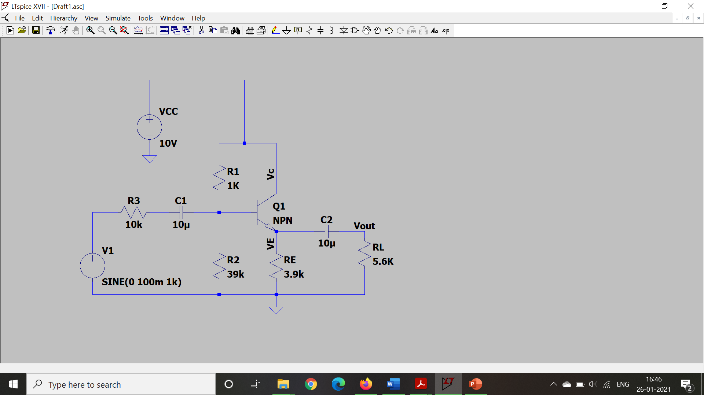
(i) Schematic of Common Collector Configuration

Slide 4
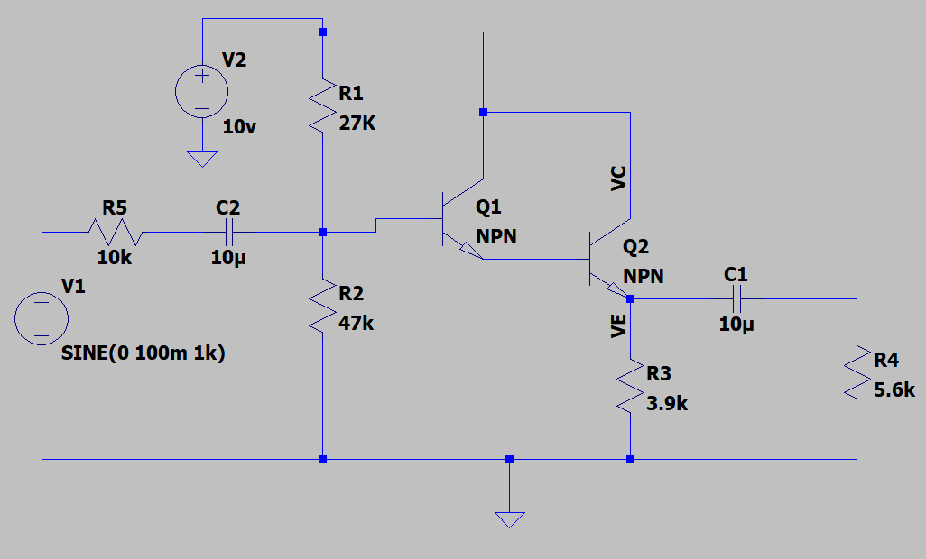
(ii) Schematic of Darlington mode Configuration

Slide 5
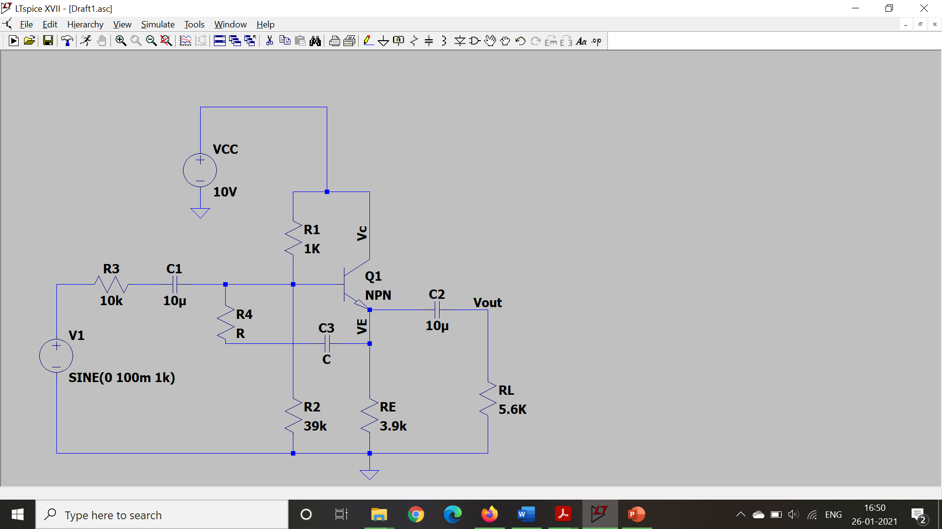
(iii) Schematic of Bootstrapped Configuration
47k
33µF

Slide 6
Assignment:
To study a common collector amplifier, Darlington mode and bootstrapped configuration.
Upload a single PdF file on which includes
Circuits
Common Collector, Darlington mode and Bootstrapped Configurations
Common collector configuration circuit used for R_{o} calculation
Voltage gain (A_{v}), V_{in}, I_{in}, V_{out}, I_{out}
Input Resistance (R_{in}),
Output Resistance (R_{out}),
Show the waveform for input and output voltages
Submit the report in single PDF format (file name must be your ID) on Nalanda till 5:00 PM (Wednesday, 03/02/2021).

Slide 7
